Slide 1

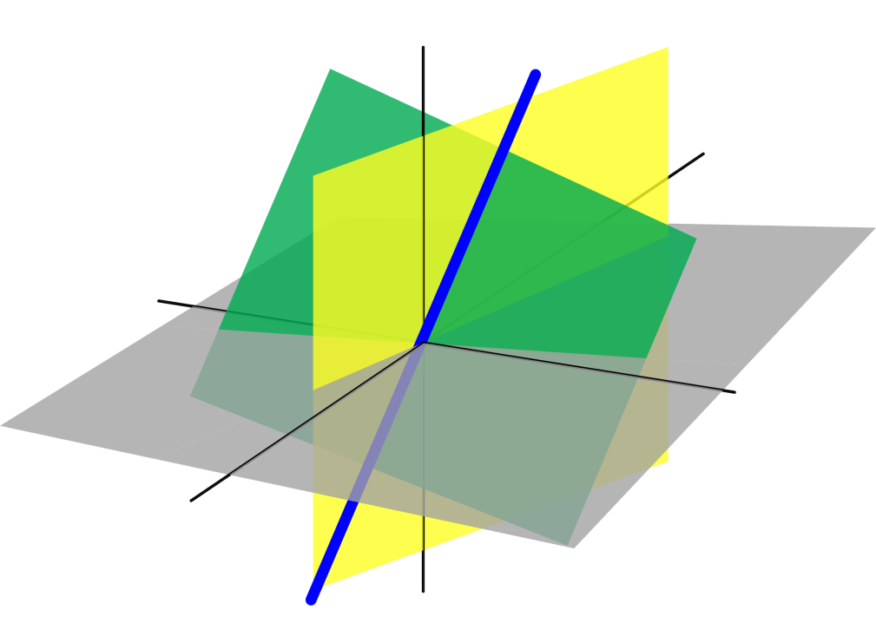
Azərbaycan Dövlət Neft və Sənaye Universiteti
Linear Algebra

Slide 2
Outline
The Determinant of a Matrix
Evaluation of a Determinant Using Elementary Operations
Properties of Determinants
Applications of Determinants
Determinants

Slide 3
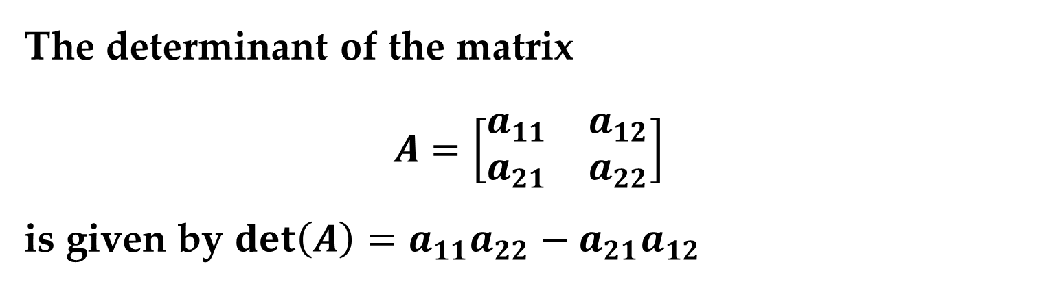
Every square matrix can be associated with a real number called its determinant.
Determinants have many uses, several of which will be explored later on.
Definition (Determinant of a $2×2$ Matrix)
The determinant of the matrix
$$A=\left[\begin{matrix}a_{11} & a_{12} \\ a_{21} & a_{22}\end{matrix}\right]$$
is given by $\det\left(A\right)=a_{11}a_{22}−a_{21}a_{12}$
The Determinant of a Matrix

Slide 4
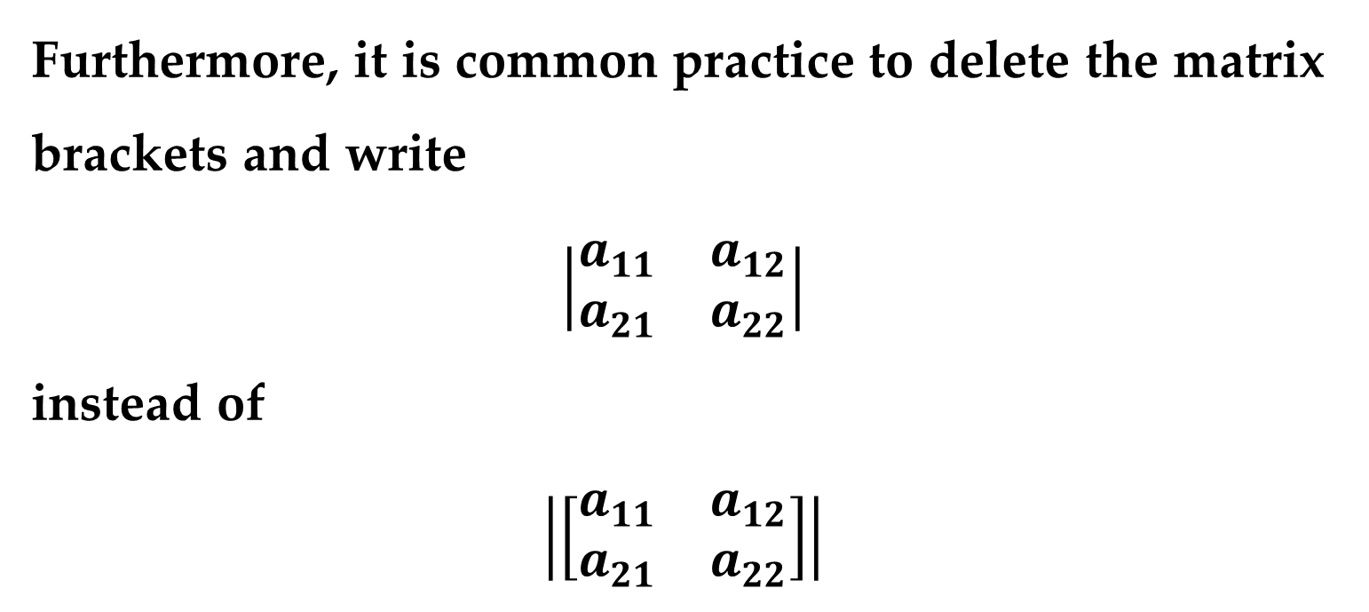
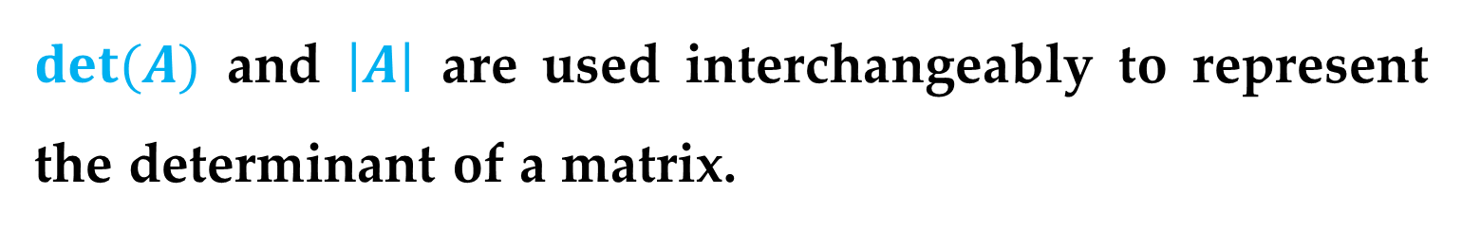
Remark
$det(A)$ and $\left|A\right|$ are used interchangeably to represent the determinant of a matrix.
Furthermore, it is common practice to delete the matrix brackets and write
$$\left|\begin{matrix}a_{11} & a_{12} \\ a_{21} & a_{22}\end{matrix}\right|$$
instead of
$$\left|\left[\begin{matrix}a_{11} & a_{12} \\ a_{21} & a_{22}\end{matrix}\right]\right|$$
The Determinant of a Matrix

Slide 5

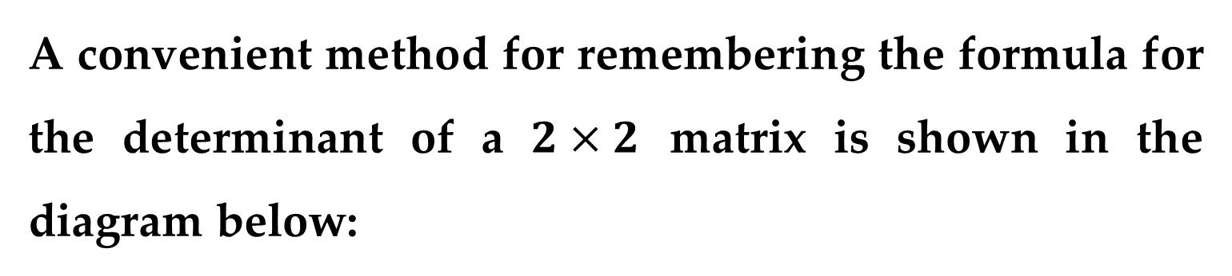
A convenient method for remembering the formula for the determinant of a $2×2$ matrix is shown in the diagram below:
The determinant is the difference of the products of the two diagonals of the matrix.
The Determinant of a Matrix

Slide 6
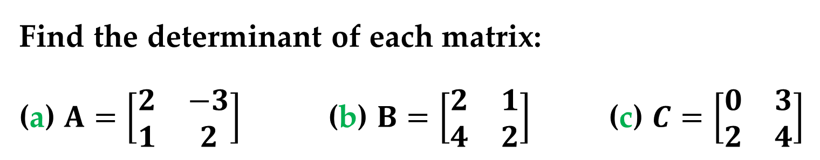
Example 1 (The Determinant of a Matrix of Order 2)
Find the determinant of each matrix:
(a) $A=\left[\begin{matrix}2 & −3 \\ 1 & 2\end{matrix}\right]$ (b) $B=\left[\begin{matrix}2 & 1 \\ 4 & 2\end{matrix}\right]$ (c) $C=\left[\begin{matrix}0 & 3 \\ 2 & 4\end{matrix}\right]$
Solution
(a) $\left|A\right|=\left|\begin{matrix}2 & −3 \\ 1 & 2\end{matrix}\right|=\left(2\right)\left(2\right)−\left(1\right)\left(−3\right)=4+3=7$
(b) $\left|B\right|=\left|\begin{matrix}2 & 1 \\ 4 & 2\end{matrix}\right|=\left(2\right)\left(2\right)−\left(1\right)\left(4\right)=4−4=0$
(c) $\left|C\right|=\left|\begin{matrix}0 & 3 \\ 2 & 4\end{matrix}\right|=\left(0\right)\left(4\right)−\left(2\right)\left(3\right)=0−6=−6$
The Determinant of a Matrix

Slide 7
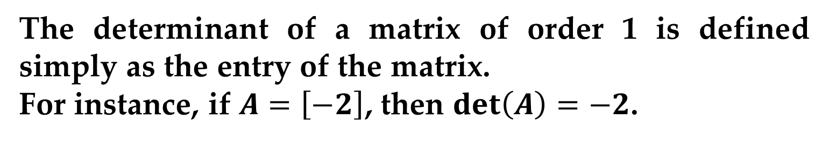
The Determinant of a Matrix
Remark
The determinant of a matrix of order 1 is defined simply as the entry of the matrix.
For instance, if $A=\left[−2\right]$, then $\det\left(A\right)=−2$.
To define the determinant of a matrix of order higher than 2, it is convenient to use the notions of minors and cofactors.

Slide 8

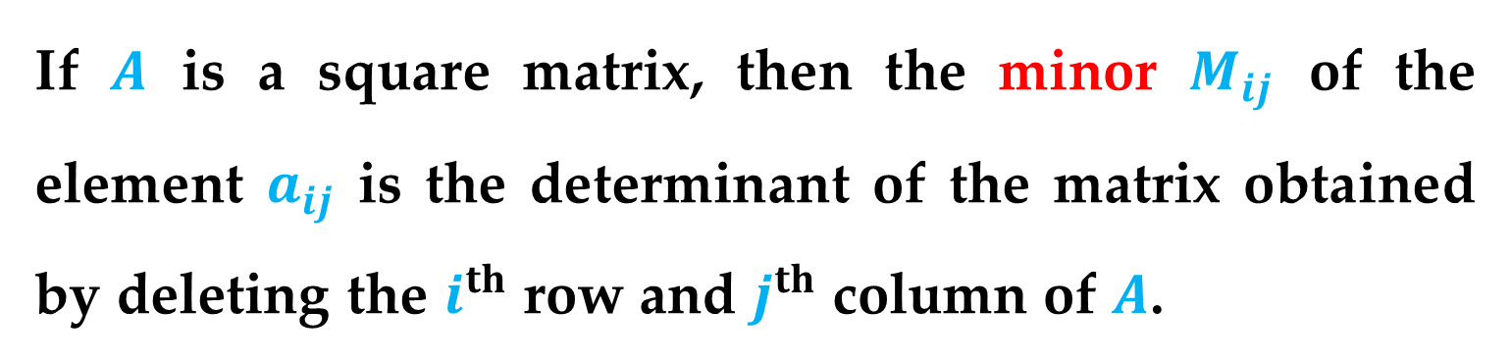
Definition (Minors and Cofactors of a Matrix)
If $A$ is a square matrix, then the minor $M_{ij}$ of the element $a_{ij}$ is the determinant of the matrix obtained by deleting the $i^{th}$ row and $j^{th}$ column of $A$.
The cofactor $C_{ij}$ is given by
$$C_{ij}={(−1)}^{i+j}M_{ij}$$
The Determinant of a Matrix

Slide 9
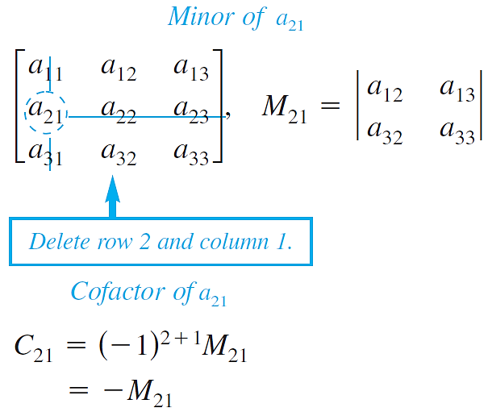
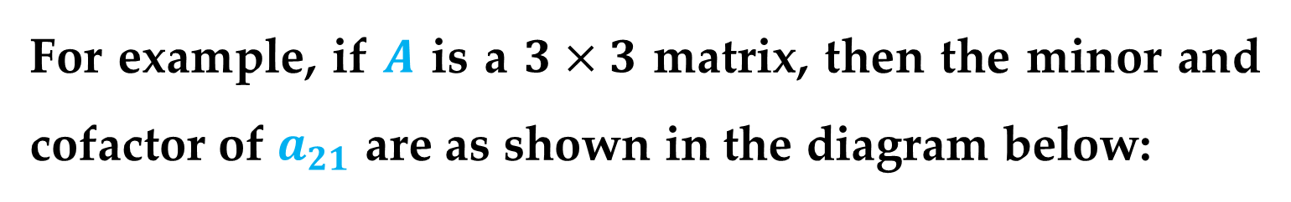
For example, if $A$ is a $3×3$ matrix, then the minor and cofactor of $a_{21}$ are as shown in the diagram below:
The Determinant of a Matrix

Slide 10
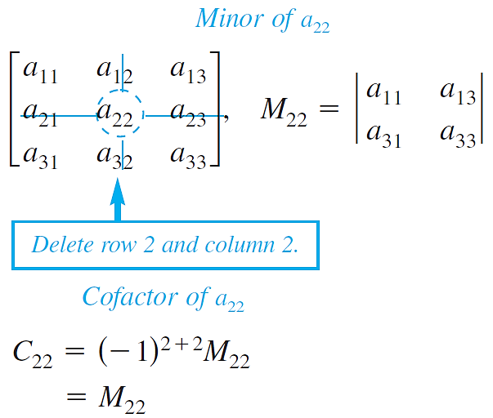
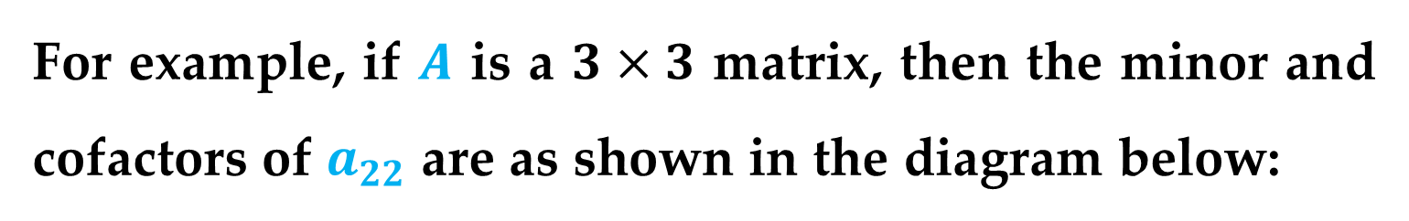
For example, if $A$ is a $3×3$ matrix, then the minor and cofactors of $a_{22}$ are as shown in the diagram below:
The Determinant of a Matrix

Slide 11
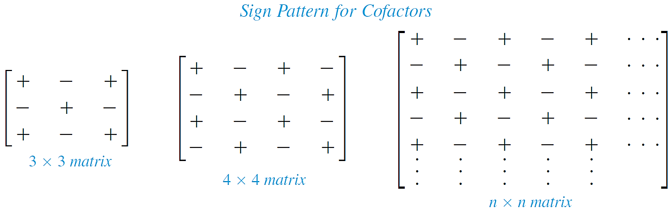
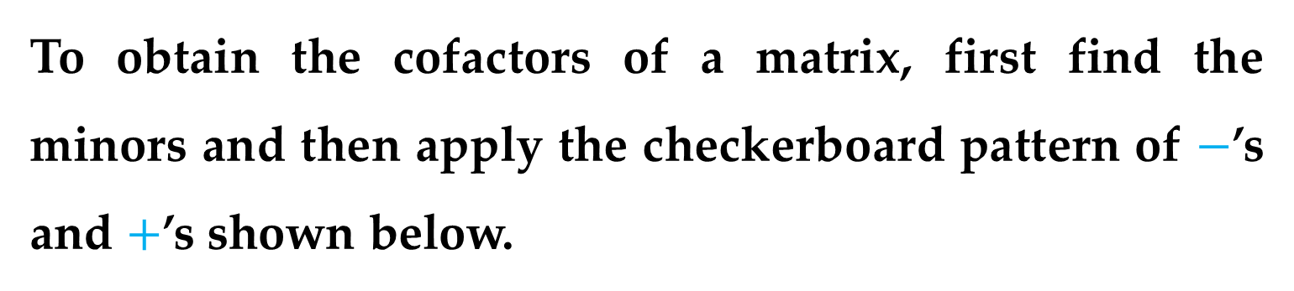
As you can see, the minors and cofactors of a matrix can differ only in sign.
To obtain the cofactors of a matrix, first find the minors and then apply the checkerboard pattern of $−$’s and $+$’s shown below.
The Determinant of a Matrix

Slide 12
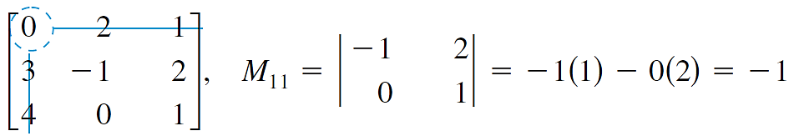
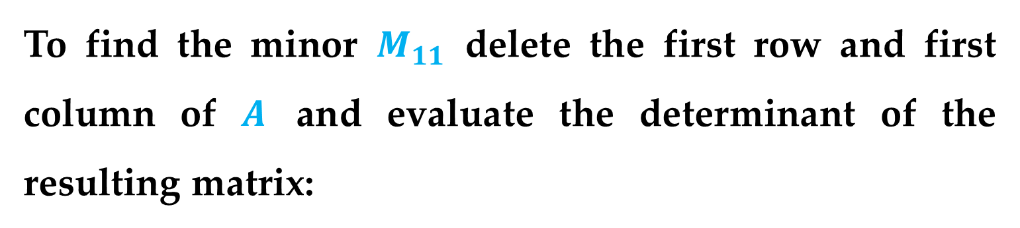

Example 2 (Find the Minors and Cofactors of a Matrix)
Find all the minors and cofactors of
$$A=\left[\begin{matrix}0 & 2 & 1 \\ 3 & −1 & 2 \\ 4 & 0 & 1\end{matrix}\right]$$
Solution
To find the minor $M_{11}$ delete the first row and first column of $A$ and evaluate the determinant of the resulting matrix:
The Determinant of a Matrix

Slide 13
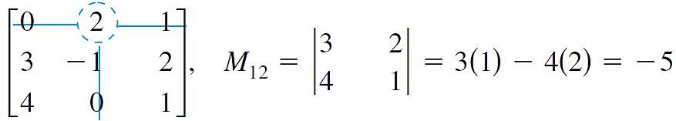
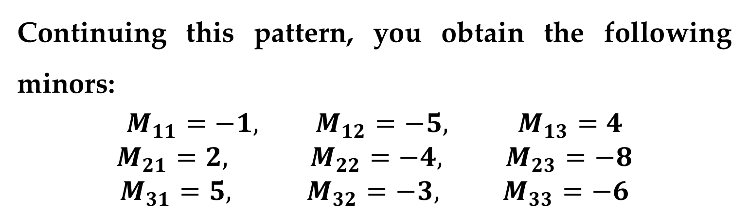
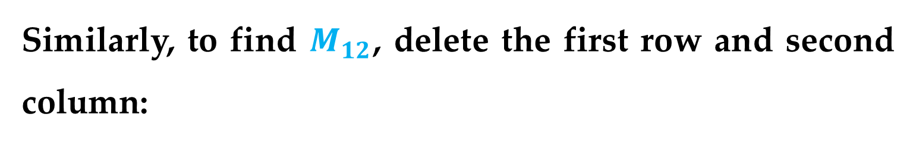
Solution (continued)
Similarly, to find $M_{12}$, delete the first row and second column:
Continuing this pattern, you obtain the following minors:
$$M_{11}=−1, M_{12}=−5, M_{13}=4$$
$$M_{21}=2, M_{22}=−4, M_{23}=−8$$
$$M_{31}=5, M_{32}=−3, M_{33}=−6$$
The Determinant of a Matrix

Slide 14
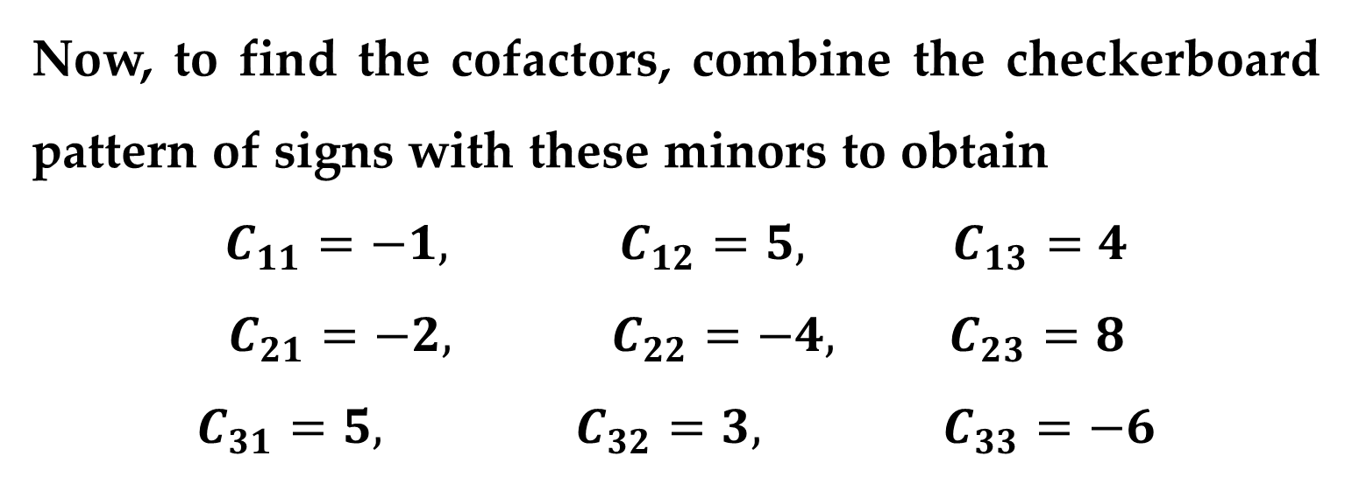
Solution (continued)
Now, to find the cofactors, combine the checkerboard pattern of signs with these minors to obtain
$$C_{11}=−1, C_{12}=5, C_{13}=4$$
$$C_{21}=−2, C_{22}=−4, C_{23}=8$$
$$C_{31}=5, C_{32}=3, C_{33}=−6$$
The Determinant of a Matrix

Slide 15
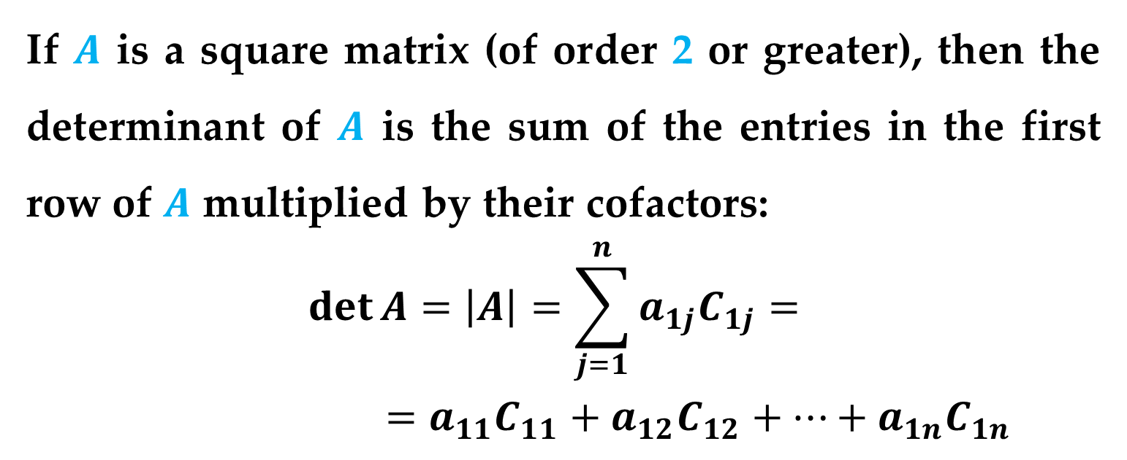
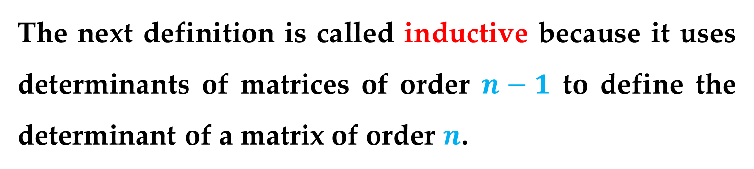
The next definition is called inductive because it uses determinants of matrices of order $n−1$ to define the determinant of a matrix of order $n$.
Definition (Determinant of a Matrix)
If $A$ is a square matrix (of order 2 or greater), then the determinant of $A$ is the sum of the entries in the first row of $A$ multiplied by their cofactors:
$$\det{A}=\left|A\right|=\sum_{j=1}^{n}{a_{1j}C_{1j}}=$$
$$=a_{11}C_{11}+a_{12}C_{12}+…+a_{1n}C_{1n}$$

Slide 16

Remark
When you use this definition to evaluate a determinant, you are expanding by cofactors in the first row.
Example 3 (The Determinant of a Matrix of Order 3)
Find the determinant of
$$A=\left[\begin{matrix}0 & 2 & 1 \\ 3 & −1 & 2 \\ 4 & 0 & 1\end{matrix}\right]$$
Solution
This matrix is the same as the one in Example 2.
The Determinant of a Matrix

Slide 17
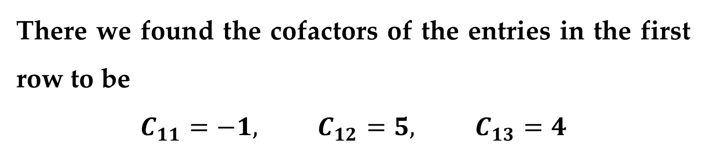
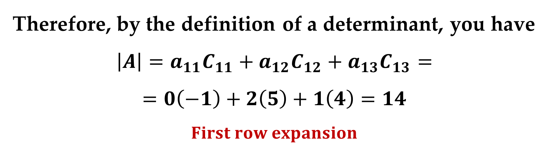
Solution (continued)
There we found the cofactors of the entries in the first row to be
$$C_{11}=−1, C_{12}=5, C_{13}=4$$
Therefore, by the definition of a determinant, you have
$$\left|A\right|=a_{11}C_{11}+a_{12}C_{12}+a_{13}C_{13}=$$
$$=0\left(−1\right)+2\left(5\right)+1\left(4\right)=14$$
$$First row expansion$$
The Determinant of a Matrix

Slide 18
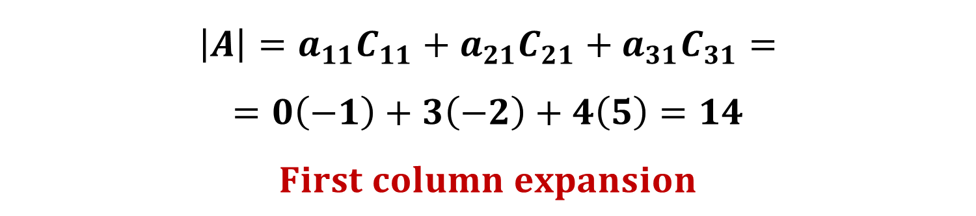
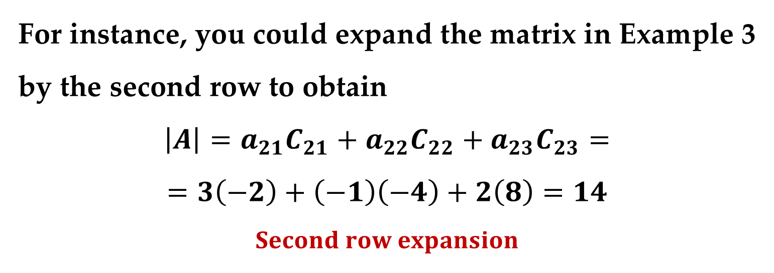
Remark
It can be shown that the determinant can be evaluated by expanding by any row or any column.
For instance, you could expand the matrix in Example 3 by the second row to obtain
$$\left|A\right|=a_{21}C_{21}+a_{22}C_{22}+a_{23}C_{23}=$$
$$=3\left(−2\right)+\left(−1\right)\left(−4\right)+2\left(8\right)=14$$
$$Second row expansion$$
$$\left|A\right|=a_{11}C_{11}+a_{21}C_{21}+a_{31}C_{31}=$$
$$=0\left(−1\right)+3\left(−2\right)+4\left(5\right)=14$$
$$First column expansion$$

Slide 19
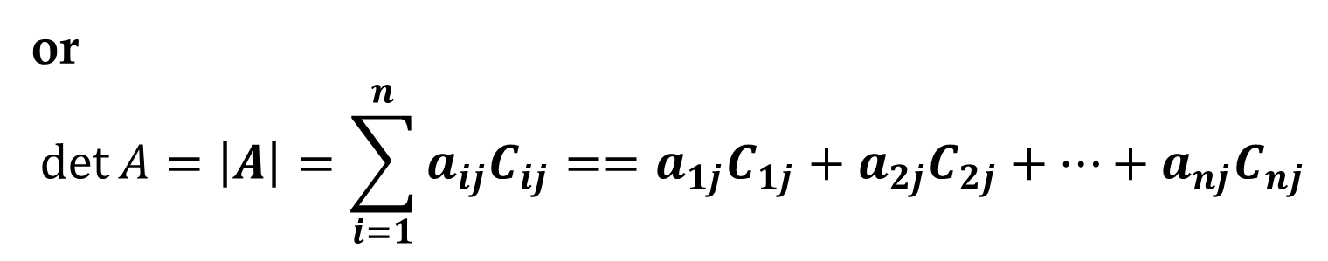
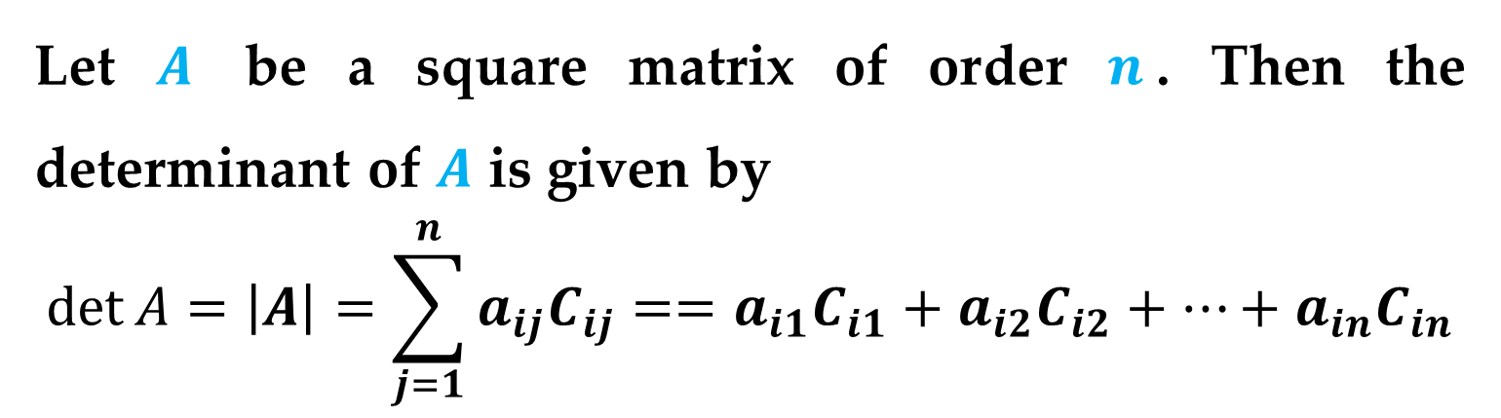


Theorem 1 (Expansion by Cofactors)
Let $A$ be a square matrix of order $n$. Then the determinant of $A$ is given by
$$\det{A}=\left|A\right|=\sum_{j=1}^{n}{a_{ij}C_{ij}}==a_{i1}C_{i1}+a_{i2}C_{i2}+…+a_{in}C_{in}$$
$$i^{th} row expansion$$
or
$$\det{A}=\left|A\right|=\sum_{i=1}^{n}{a_{ij}C_{ij}}==a_{1j}C_{1j}+a_{2j}C_{2j}+…+a_{nj}C_{nj}$$
$$j^{th} column expansion$$
The Determinant of a Matrix

Slide 20
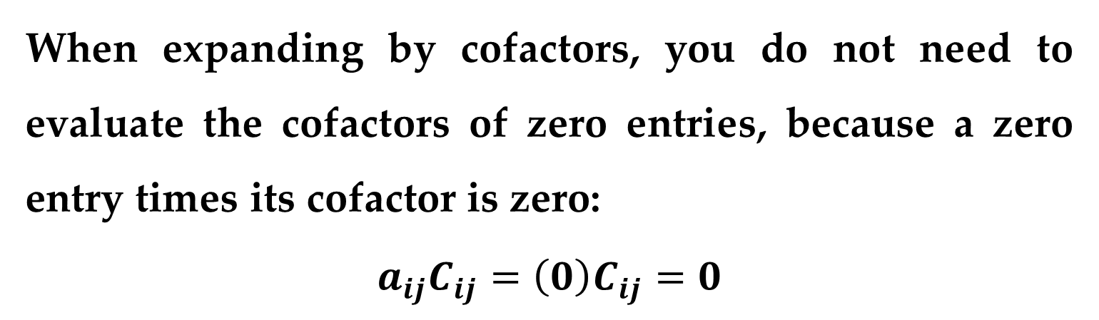
Remark
When expanding by cofactors, you do not need to evaluate the cofactors of zero entries, because a zero entry times its cofactor is zero:
$$a_{ij}C_{ij}=\left(0\right)C_{ij}=0$$
Which column (row) should you choose when expanding by cofactors?
The row (or column) containing the most zeros is usually the best choice for expansion by cofactors.
The Determinant of a Matrix

Slide 21

Example 4 (The Determinant of a Matrix of Order 4)
Find the determinant of
$$A=\left[\begin{matrix}\begin{matrix}1 & −2 \\ −1 & 1\end{matrix} & \begin{matrix}3 & 0 \\ 0 & 2\end{matrix} \\ \begin{matrix}0 & 2 \\ 3 & 4\end{matrix} & \begin{matrix} 0 & 3 \\ 0 & −2\end{matrix}\end{matrix}\right]$$
Solution
By inspecting this matrix, you can see that three of the entries in the third column are zeros.
The Determinant of a Matrix

Slide 22
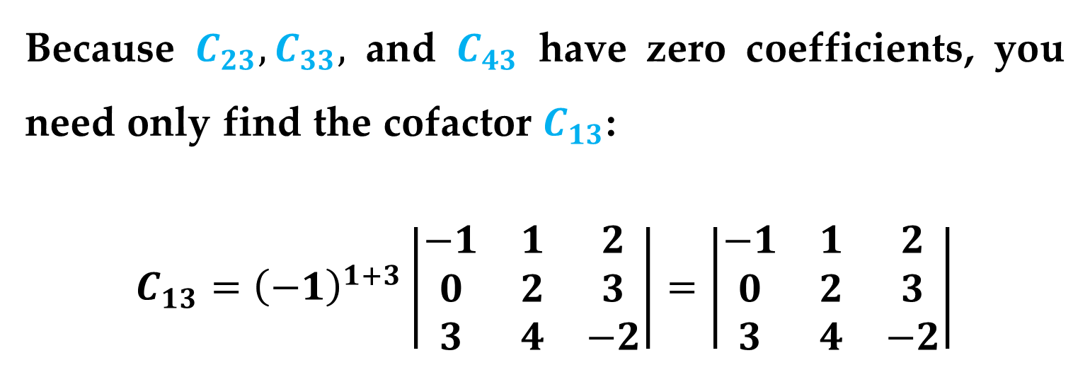
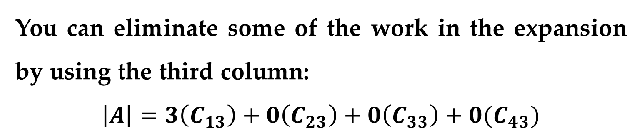
Solution (continued)
You can eliminate some of the work in the expansion by using the third column:
$$\left|A\right|=3\left(C_{13}\right)+0\left(C_{23}\right)+0\left(C_{33}\right)+0(C_{43})$$
Because $C_{23}, C_{33},$ and $C_{43}$ have zero coefficients, you need only find the cofactor $C_{13}$:
$$C_{13}={\left(−1\right)}^{1+3}\left|\begin{matrix}−1 & 1 & 2 \\ 0 & 2 & 3 \\ 3 & 4 & −2\end{matrix}\right|=\left|\begin{matrix}−1 & 1 & 2 \\ 0 & 2 & 3 \\ 3 & 4 & −2\end{matrix}\right|$$
The Determinant of a Matrix

Slide 23
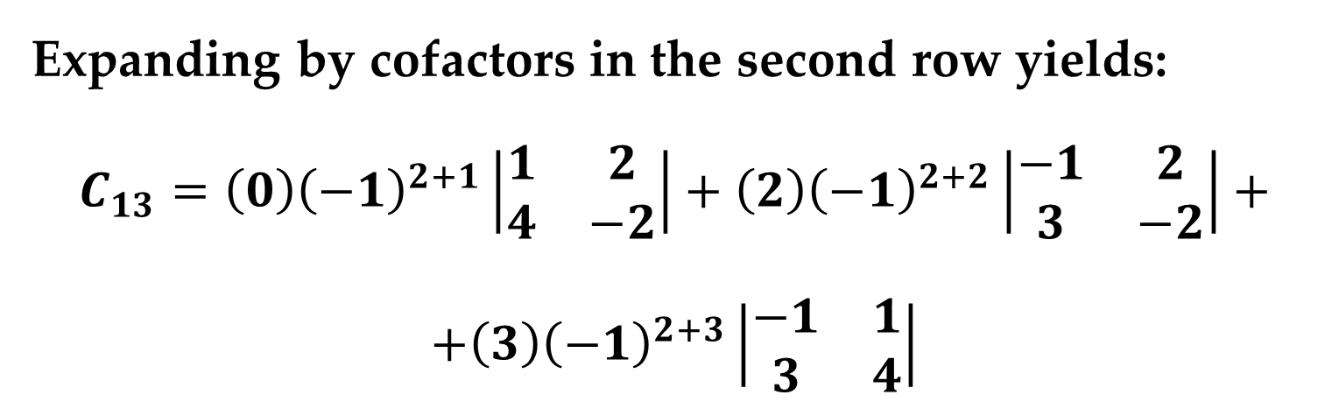
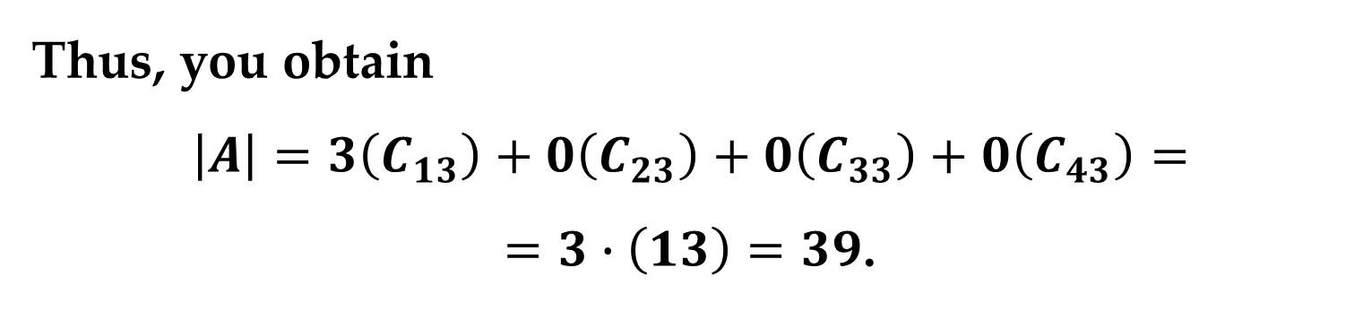
Solution (continued)
Expanding by cofactors in the second row yields:
$$C_{13}=\left(0\right){\left(−1\right)}^{2+1}\left|\begin{matrix}1 & 2 \\ 4 & −2\end{matrix}\right|+\left(2\right){\left(−1\right)}^{2+2}\left|\begin{matrix}−1 & 2 \\ 3 & −2\end{matrix}\right|+$$
$$+\left(3\right){\left(−1\right)}^{2+3}\left|\begin{matrix}−1 & 1 \\ 3 & 4\end{matrix}\right|$$
$$C_{13}=0+2\left(2−6\right)−3\left(−4−3\right)=−8+21=13$$
Thus, you obtain
$$\left|A\right|=3\left(C_{13}\right)+0\left(C_{23}\right)+0\left(C_{33}\right)+0\left(C_{43}\right)=$$
$=3∙\left(13\right)=39$.
The Determinant of a Matrix

Slide 24
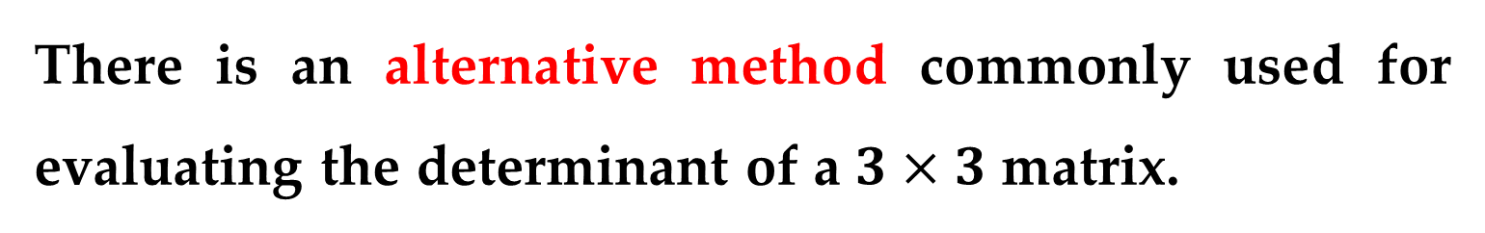
There is an alternative method commonly used for evaluating the determinant of a $3×3$ matrix.
To apply this method, copy the first and second columns of the matrix to form fourth and fifth columns.
The determinant of the matrix is then obtained by adding (or subtracting) the products of the six diagonals, as shown in the following diagram.
The Determinant of a Matrix

Slide 25
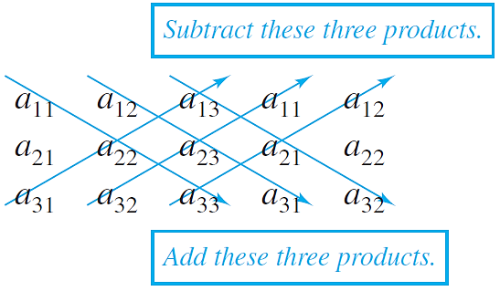
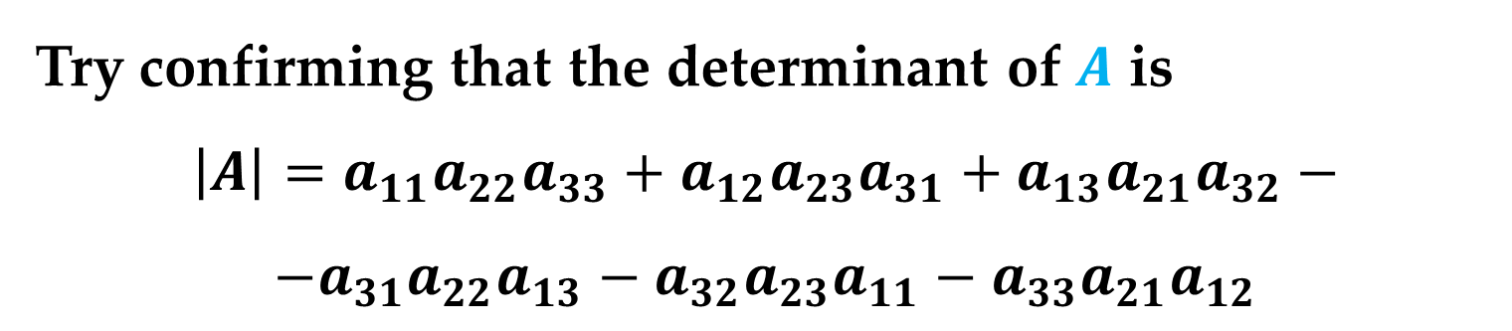
Try confirming that the determinant of $A$ is
$$\left|A\right|=a_{11}a_{22}a_{33}+a_{12}a_{23}a_{31}+a_{13}a_{21}a_{32}−$$
$$−a_{31}a_{22}a_{13}−a_{32}a_{23}a_{11}−a_{33}a_{21}a_{12}$$
The Determinant of a Matrix

Slide 26
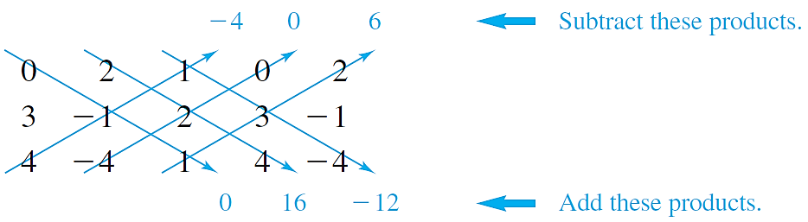

Example 5 (The Determinant of a Matrix of Order 3)
Find the determinant of
$$A=\left[\begin{matrix}0 & 2 & 1 \\ 3 & −1 & 2 \\ 4 & −4 & 1\end{matrix}\right]$$
Solution
Begin by recopying the first two columns and then computing the six diagonal products as follows.
The Determinant of a Matrix

Slide 27
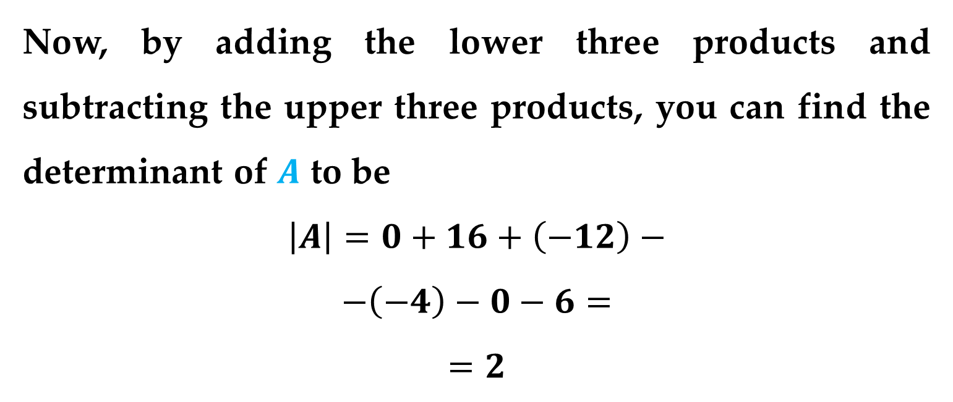
Solution (continued)
Now, by adding the lower three products and subtracting the upper three products, you can find the determinant of $A$ to be
$$\left|A\right|=0+16+\left(−12\right)−$$
$$−\left(−4\right)−0−6=$$
$$=2$$
The Determinant of a Matrix

Slide 28
Evaluating determinants of matrices of order 4 or higher can be tedious.
There is, however, an important exception: the determinant of a triangular matrix.
A square matrix is called upper triangular if it has all zero entries below its main diagonal.
A square matrix is called lower triangular if it has all zero entries above its main diagonal.
Triangular Matrices

Slide 29
A matrix that is both upper and lower triangular is called diagonal.
That is, a diagonal matrix is one in which all entries above and below the main diagonal are zero.
Triangular Matrices

Slide 30
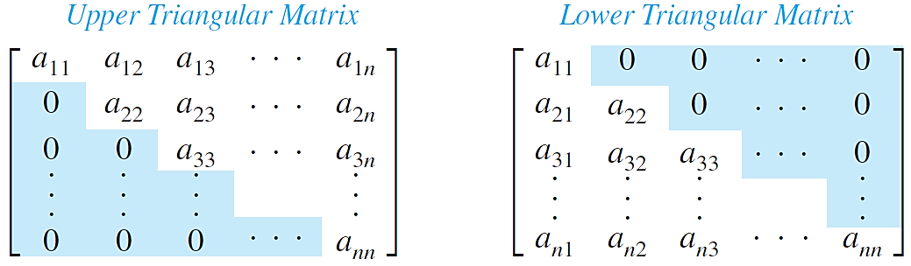
To find the determinant of a triangular matrix, simply form the product of the entries on the main diagonal.
It is easy to see that this procedure is valid for triangular matrices of order 2 or 3.
Triangular Matrices

Slide 31
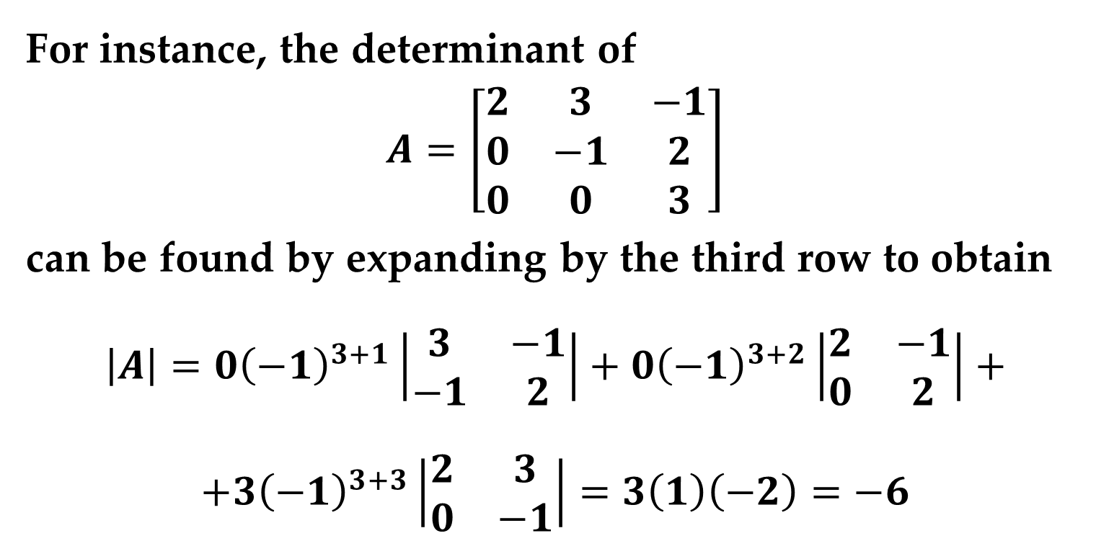
For instance, the determinant of
$$A=\left[\begin{matrix}2 & 3 & −1 \\ 0 & −1 & 2 \\ 0 & 0 & 3\end{matrix}\right]$$
can be found by expanding by the third row to obtain
$$\left|A\right|=0{\left(−1\right)}^{3+1}\left|\begin{matrix}3 & −1 \\ −1 & 2\end{matrix}\right|+0{\left(−1\right)}^{3+2}\left|\begin{matrix}2 & −1 \\ 0 & 2\end{matrix}\right|+$$
$$+3{\left(−1\right)}^{3+3}\left|\begin{matrix}2 & 3 \\ 0 & −1\end{matrix}\right|=3\left(1\right)\left(−2\right)=−6$$
which is the product of the entries on the main diagonal.
Triangular Matrices

Slide 32
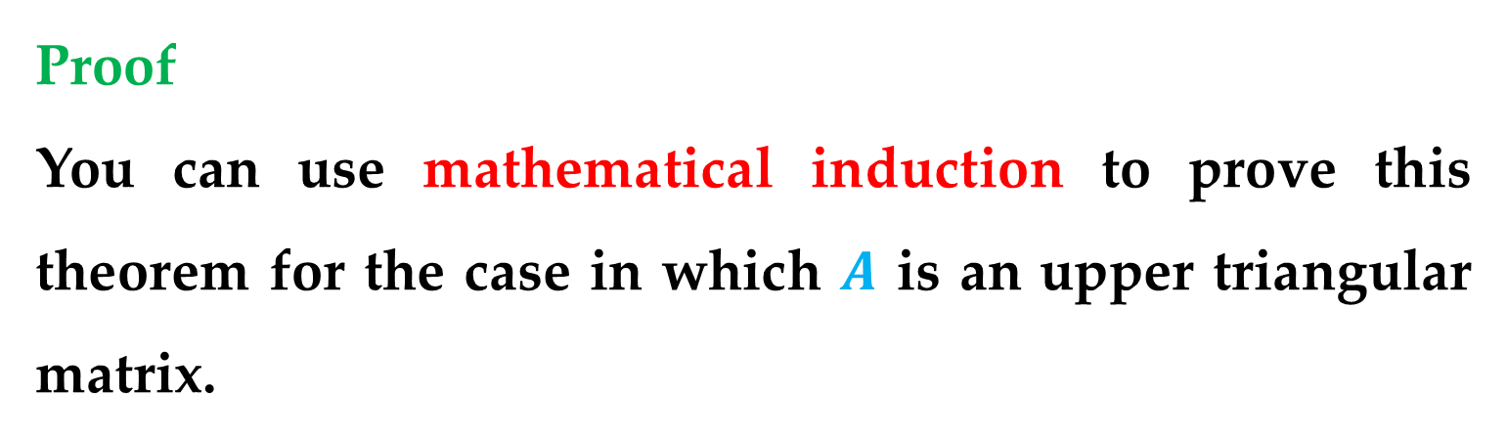
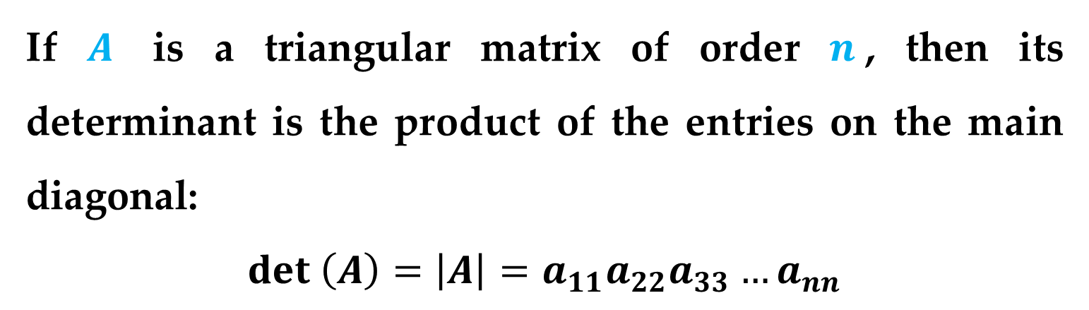
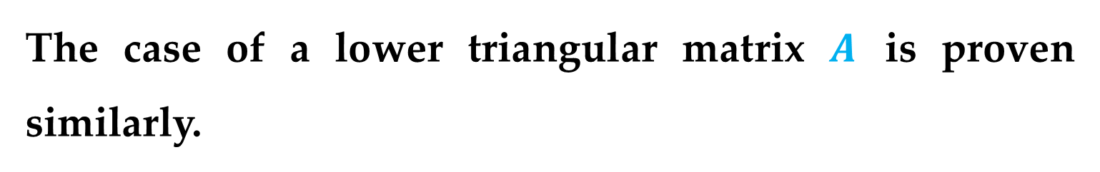
Theorem 2 (Determinant of a Triangular Matrix)
If $A$ is a triangular matrix of order $n$, then its determinant is the product of the entries on the main diagonal:
$$det \left(A\right)=\left|A\right|=a_{11}a_{22}a_{33}…a_{nn}$$
Proof
You can use mathematical induction to prove this theorem for the case in which $A$ is an upper triangular matrix.
The case of a lower triangular matrix $A$ is proven similarly.

Slide 33
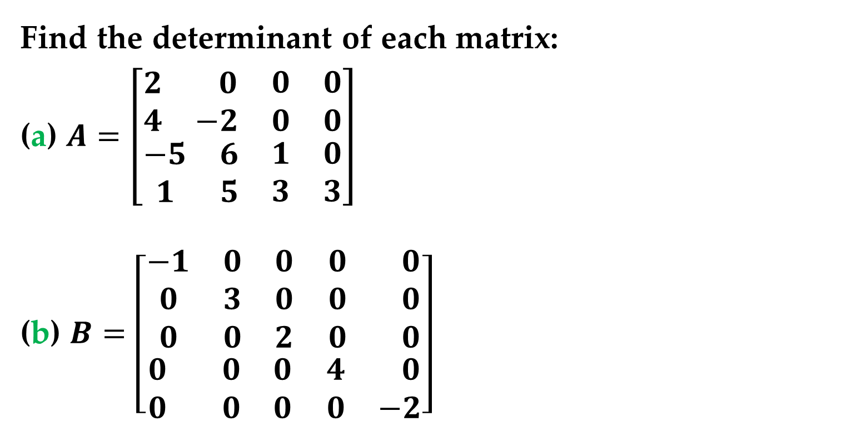
Example 6 (The Determinant of a Triangular Matrix)
Find the determinant of each matrix:
(a) $A=\left[\begin{matrix}\begin{matrix}2 & 0 \\ 4 & −2\end{matrix} & \begin{matrix}0 & 0 \\ 0 & 0\end{matrix} \\ \begin{matrix}−5 & 6 \\ 1 & 5\end{matrix} & \begin{matrix}1 & 0 \\ 3 & 3\end{matrix}\end{matrix}\right]$
(b) $B=\left[\begin{matrix}\begin{matrix}−1 & 0 & 0 \\ 0 & 3 & 0 \\ 0 & 0 & 2\end{matrix} & \begin{matrix}0 & 0 \\ 0 & 0 \\ 0 & 0\end{matrix} \\ \begin{matrix}0 & 0 & 0 \\ 0 & 0 & 0\end{matrix} & \begin{matrix}4 & 0 \\ 0 & −2\end{matrix}\end{matrix}\right]$
Triangular Matrices

Slide 34
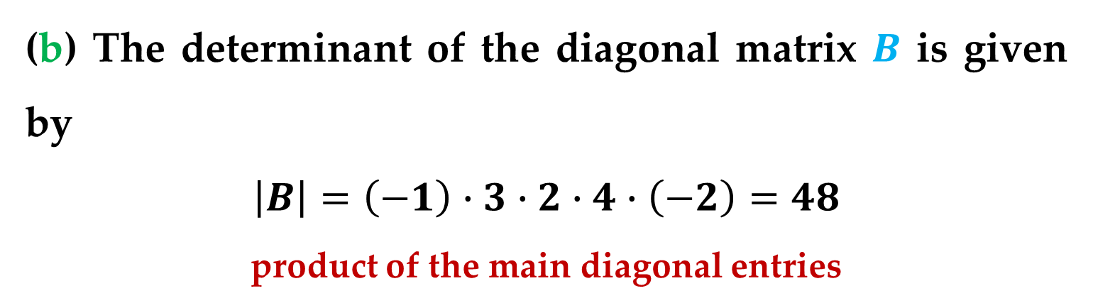
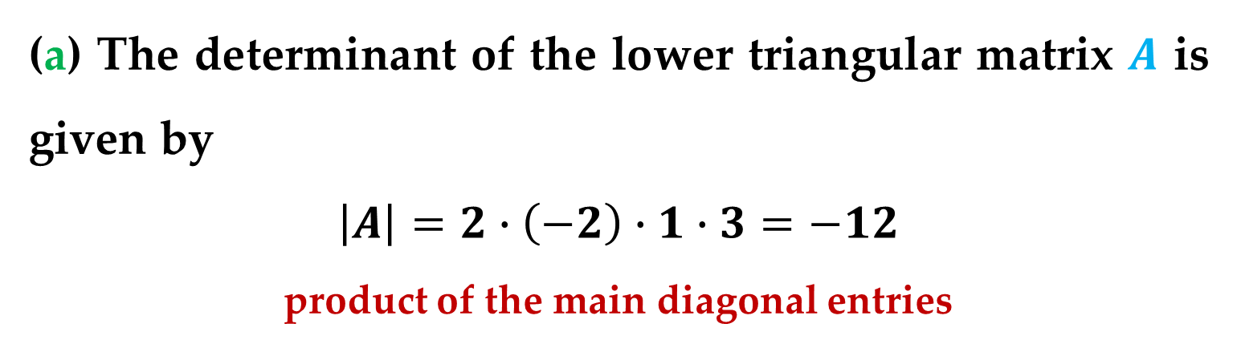
Solution
(a) The determinant of the lower triangular matrix $A$ is given by
$$\left|A\right|=2∙\left(−2\right)∙1∙3=−12$$
product of the main diagonal entries
(b) The determinant of the diagonal matrix $B$ is given by
$$\left|B\right|=\left(−1\right)∙3∙2∙4∙\left(−2\right)=48$$
product of the main diagonal entries
Triangular Matrices

Slide 35
Thank You for Attention

